Slide 1
Superintendent’s Report Dr. David Fine Peekskill City School District: A System Focused on Every Student; Every Day.
Meeting of the Board of Education
October 27, 2015

Slide 2
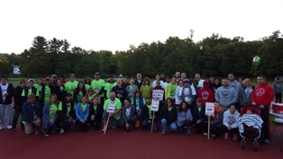
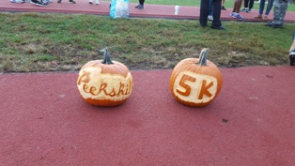

Slide 3
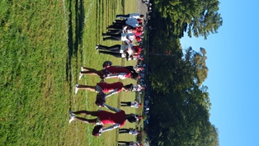
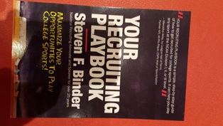
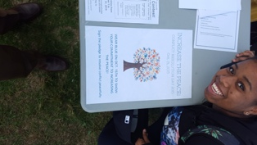
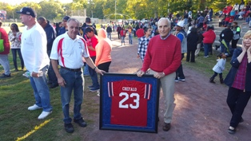
Homecoming
Binder
Club Rush

Slide 4
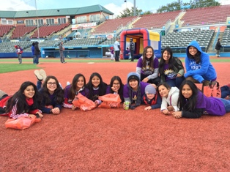
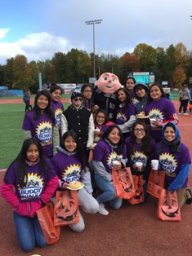
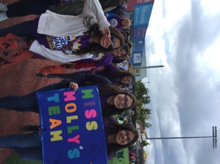
Buddy Walk Varsity Girls Team, Soccer

Slide 5
Top-Ten (10) Reasons Peekskill is a Wonderful Place to Live and Learn
10. The Art Partnerships in the City
9. Men Who Cook at the Youth Bureau
8. 75th Celebrations of the City
7. Cabinet Walkthroughs and Transparency
6. Coaches of the Year
5. Student/Athletes and Progress
4. The Power of Peace
3. Club Rush (Outdoors)
2. Nationally Recognized Speakers (Steve Binder)
1. The Seussification of Romeo and Juliet

Slide 6
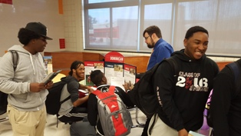
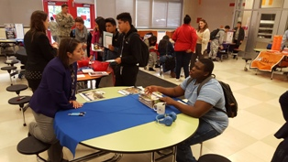
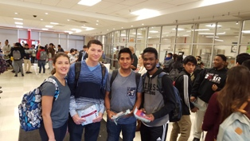
College Fair at PHS

Slide 7
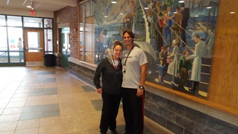
Coaches of the Year
Jon Iasillo, Boys Varsity Soccer and Cami Basso, Girls Varsity Soccer (2nd year in a row)

Slide 8
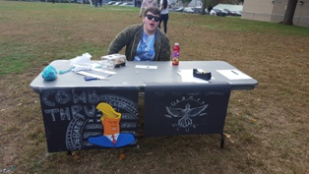
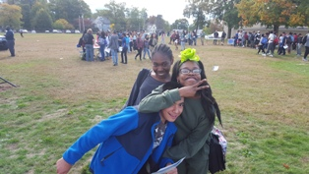
Parent/Student Portal
Student schedules, progress reports, grades, assignments, and academic information will only be available on the Parent Portal starting on November 18th, for grades 6-12.
If you have not done so already, please set up an account on the portal by November 13th.
The Login link to the Parent Portal and instructions for creating a new account can be found on our website www.peekskillcsd.org under the parents link on the horizontal navigation bar (Click on Infinite Campus Parent Portal) or you may pick up the Parent Portal Request Form at your child’s school.

Slide 9
Student Council Report
Davonte Woodton – Presenter (Moved to 11/3 Meeting)

Slide 10
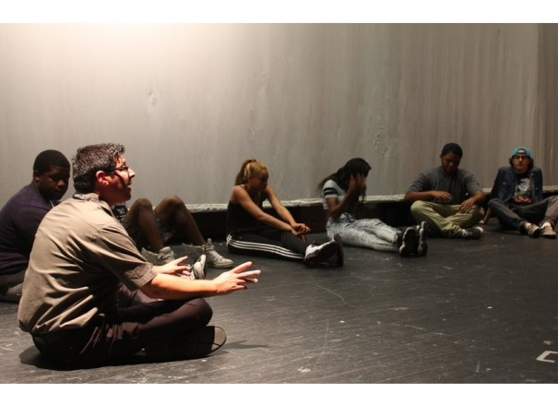
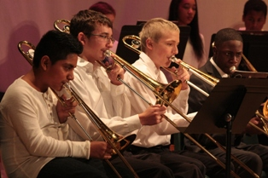
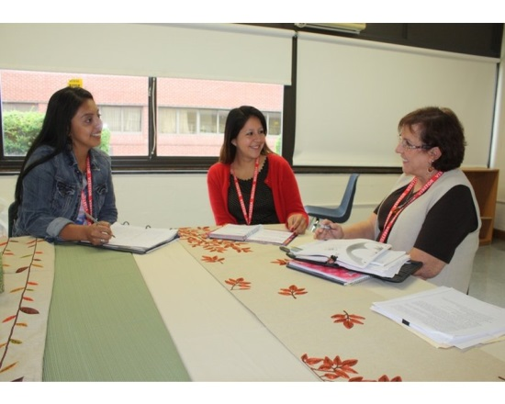
Awards at NYSSBA for Excellence in Communication
New Theater Program Takes Center Stage at PCSD
http://patch.com/new-york/peekskill/new-theater-program-takes-center-stage-pcsd
New Community Schools Initiative Program Comes to Hillcrest Elementary
http://patch.com/new-york/peekskill/new-community-schools-initiative-program-comes-hillcrest-elementary

Slide 11
Contracts Under $10,000
Body4Brain; Provide One Sensory Processing Disorder (SPD) Evaluation for a student as specified in Stipulation of Agreement; October 1, 2015 - June 30, 2016; $1,300
Susan Piowaty; Provide Professional Development services; 2015-2016 School Year; Not to exceed $1,500. Funding is from IDEA 611 Grant.
Beth and Scott and Friends/Uriah Hill; Provide music classes for PreK students; September 2015 - June 2016; $3,000
Crossover Yoga Project/Uriah Hill; Provide yoga and movement to PreK students; 2015-2016 School Year; $4,160; Funding from the Universal PreK grant
Hudson River HealthCare/LEAP-PKMS; Provides the following programs: Fit4Ever, Youth Talk, ECHO; July 1, 2015 - June 30, 2016; $6,500
Grants/Donations Under $5,000
Taconic Road Runners Club/Peekskill High School; To be used by the music program; $1,000
IBM/Peekskill Middle School; To aid in the enhancement of STEM Learning; $2,000
Rochelle Mitlak of Chappaqua; Gift of an electric piano and electric guitar; estimated value $500

Slide 12
Safety/Security
Security Presentation
Presenters: David Santiago and Altaris

Slide 13
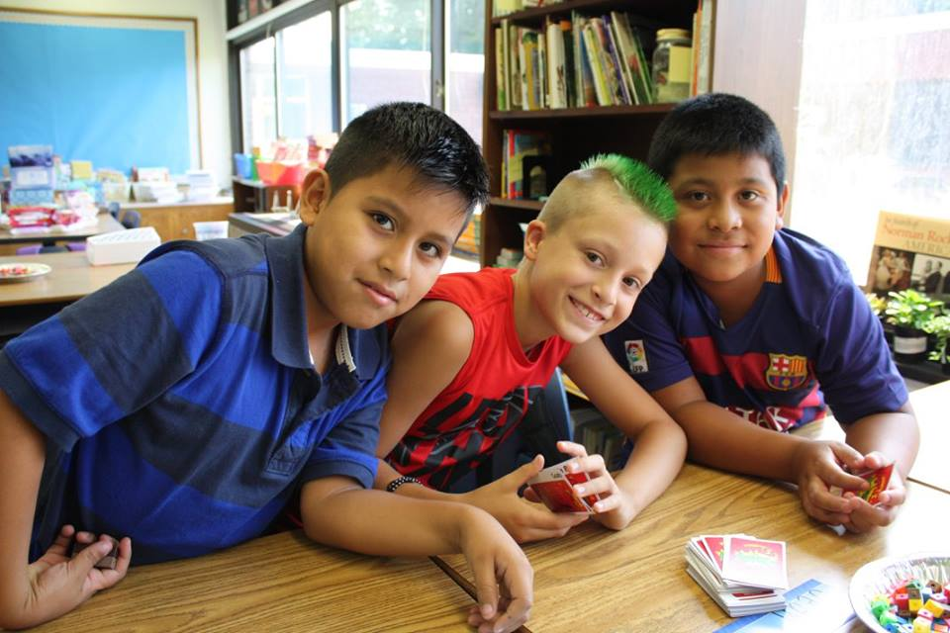
Thank You and Enjoy the Evening Have A Successful 2015-2016 School Year
*This Concludes the Superintendent’s Report
--Be Good to Yourself and Each Other--
“Be the Change you wish to see in the World.”
M. Ghandi

